Slide 1
Chapter 17
Recommender Systems
Problem formulation
1
It is important application of machine learning.
And so improvement in performance of a recommender system can have a substantial and immediate impact on the bottom line of many of these companies.
The problem of recommender systems, actually receives relatively little attention or at least it’s sort of a smaller fraction of what goes on within Academia.
2
As we approach the last few sets of video of this class, I want to talk about a few of the big ideas in machine learning and share with you, some big idea of machine learning.
For some problems, there are algorithms that can try to automatically learn a good set of features for you. So rather than hand design or hand code the features, there are a few settings where you might be able to have an algorithm just to learn what features to use. And recommender system is just one example of that sort of setting.

Slide 2
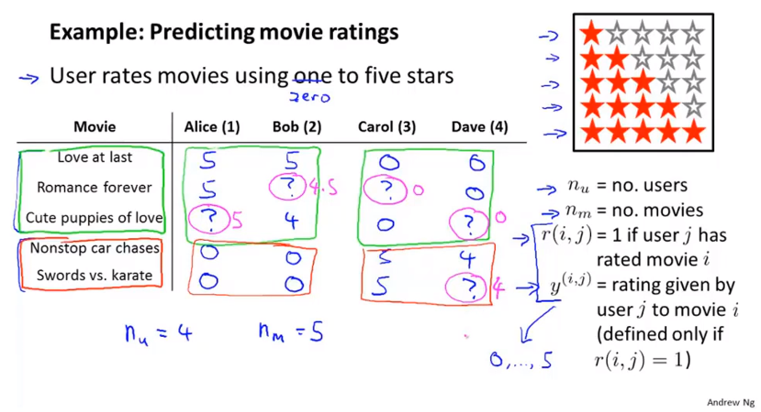
Chapter 17
And so, our job in developing a recommender system is to come up with a learning algorithm that can automatically fill in the missing values for us.

Slide 3
Chapter 17
Recommender Systems
Content-based recommendation

Slide 4
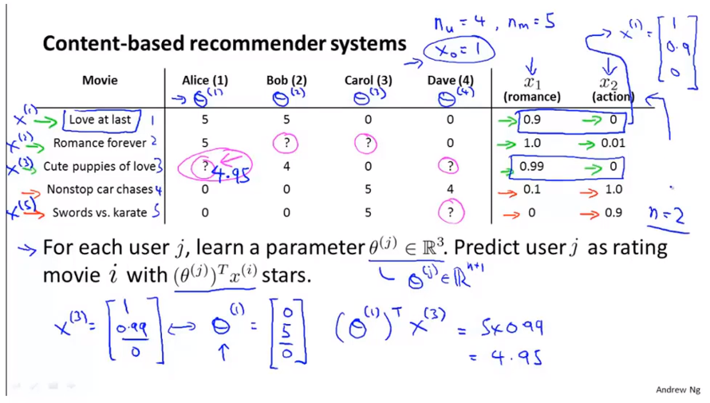
Chapter 17
We can treat predicting the ratings of each user as a separate linear regression problem.

Slide 5
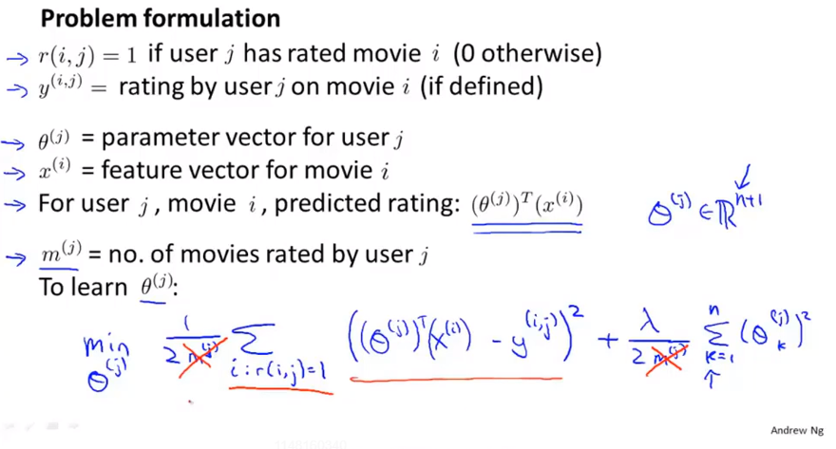
Chapter 17

Slide 6
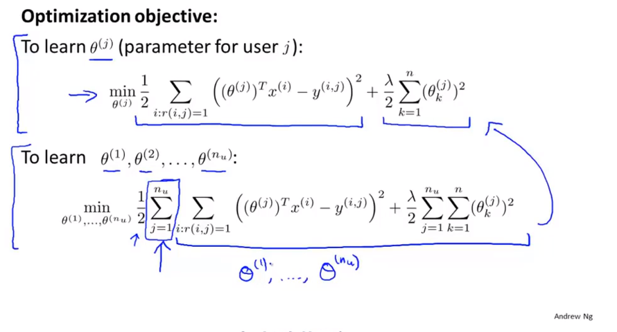
Chapter 17

Slide 7
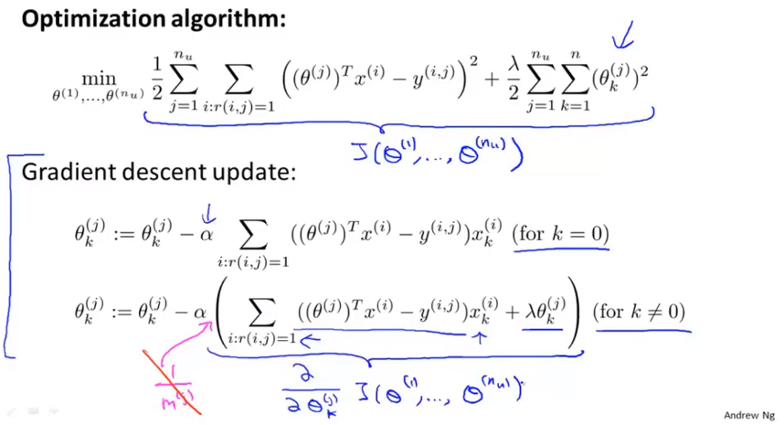
Chapter 17
These are essentially are the same as linear regression. The only minor difference is that for linear regression we have these 1 over m terms.
If you are suing gradient descent, here is how you can minimize the cost function J to learn all the parameters and using these formulas for the derivatives, If you want, you can also plug them into a more advanced optimization algorithm like cluster gradient or LBFGS or what have you, and use that to try to minimize the cost function J as well.

Slide 8
Chapter 17
This particular algorithm is called a content based recommendations, or content based approach. Because we assume that we have available to us, features for the different movies. And so we have features that capture what is the content of these movies. So, how romantic is this movie? How much action is in this movie? And we really using features of the content of the movies to make our predictions.
But for many movies, we don’t actually have such features or may be very difficult to get such features for all of our movies, for all of whatever items we are trying to sell.
So in the next video, we’ll start to talk about an approach to recommend this systems that isn’t content based and does not assume that we have someone else giving us all of these features, for all of the movies in our data set.

Slide 9
Chapter 17
Recommender Systems
Collaborative filtering
协同过滤
The algorithm that we’re talking about has a very interesting property that it does what is called feature learning. And by that I mean that this will be an algorithm that can start to learn for itself what features to use.

Slide 10
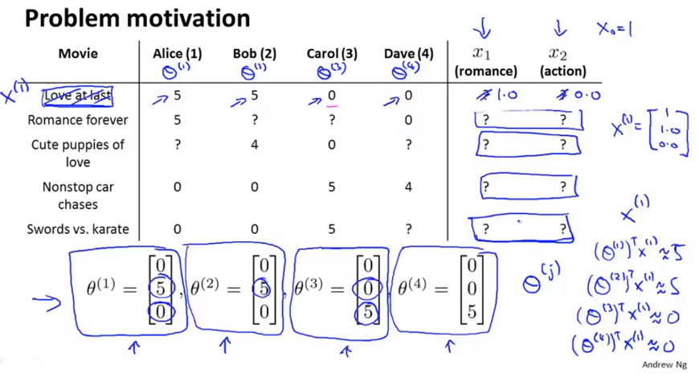
Chapter 17
That makes sense given what we know of Alice, Bob, Carol and Dave’s preferences for movies and the way they rated this movie.

Slide 11
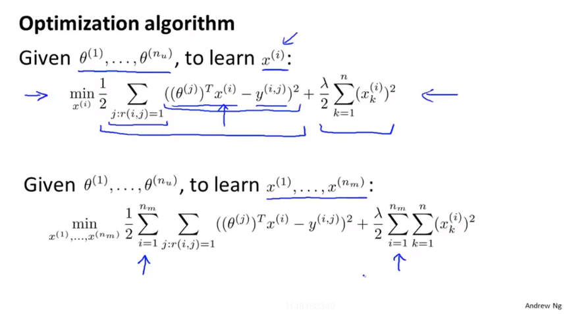
Chapter 17

Slide 12
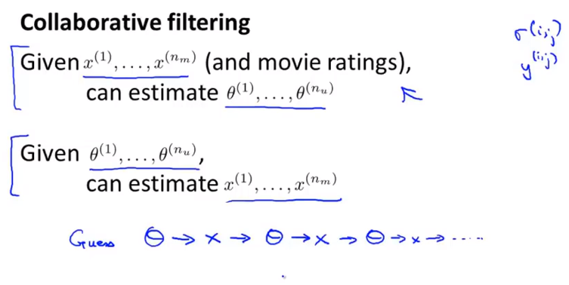
Chapter 17
But hopefully this give you the sense that how you can formulate a problem where you can simultaneously learn the parameters and simultaneously learn the features from the different movies. And for this problem, for the recommender system problem, this is possible only because each user rates multiple movies and hopefully each movie is rated by multiple users.
And so you can do this back and forth process to estimate theta and x

Slide 13
Chapter 17
So to summarize, in this video we’ve seen an initial collaborative filtering algorithm. The term collaborative filtering refers to the observation that when you run the algorithm with a large set of users, what all of these users are effectively doing are sort of collaborating to get better rating for everyone because every user rating some subset of the movies, every user is helping the algorithm a little bit to learn better features and then by helping, by rating a few movies myself, I will be helping the system learn better features and the features can be used by the system to make better movie predictions for everyone else. And there is a sense of collaboration where every user is helping the system learn better features for the common good.
This is the collaborative filtering.

Slide 14
Chapter 17
Recommender Systems
Collaborative filtering algorithm
First, if you’re given features for movies, you can use that to learn parameters theta for users.
And second, if you’re given parameters for the users, you can use that to learn features for the movies.
We’re going to take those ideas and put them together to come up with a collaborative filtering algorithm.

Slide 15
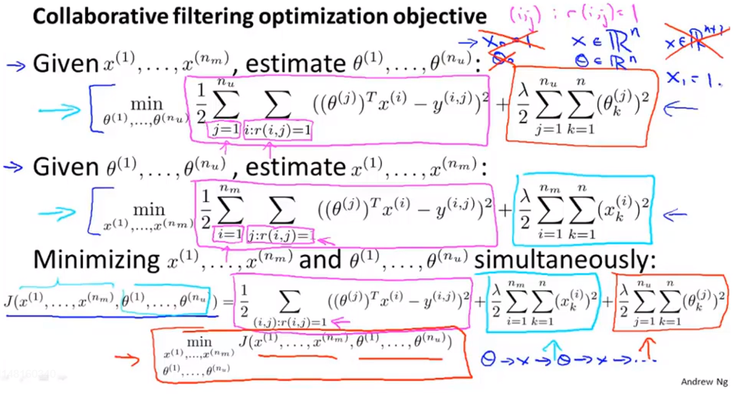
Chapter 17
Minimize with respect to both sets of parameters simultaneously.
We’re now learning all the features, so there is no need to hard code the feature that is always equals to one. Because the algorithm really wants a features that is always equal to 1, it can choose to learn one for itself. So if the algorithm chooses, it can set the feature X1 equals 1. So there’s no need to hard code the feature of x0 to 1, the algorithm now has the flexibility to just learn it by itself.

Slide 16
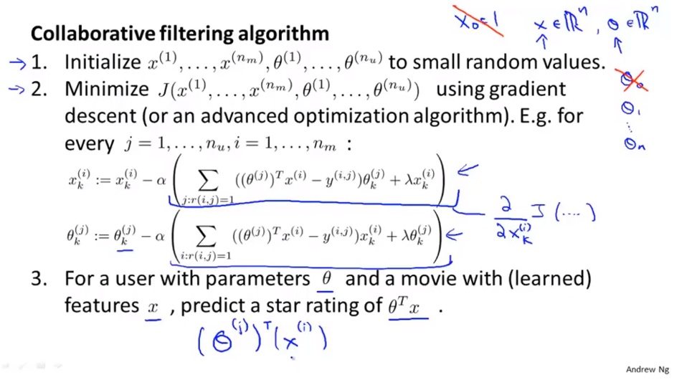
Chapter 17

Slide 17
Chapter 17
So that’s the collaborative filtering algorithm. And if you implement this algorithm, you actually get a pretty descent algorithm that will simultaneously learning good features for hopefully all the movies as well as learn parameters for all the users and hopefully give pretty good predictions for how different users will rate different movies that they have not yet rated.

Slide 18
Chapter 17
Recommender Systems
Vectorization:
Low rank matrix factorization
The vectorization implementation of this algorithm.
Other things you can do with this algorithm.
For example, one of the things you can do is given one product can you find other product that are related to this .

Slide 19
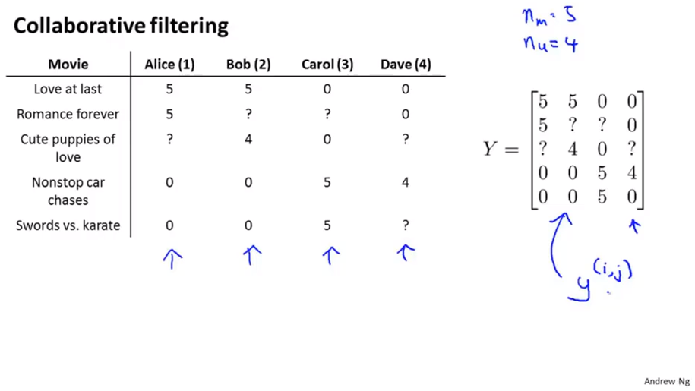
Chapter 17

Slide 20
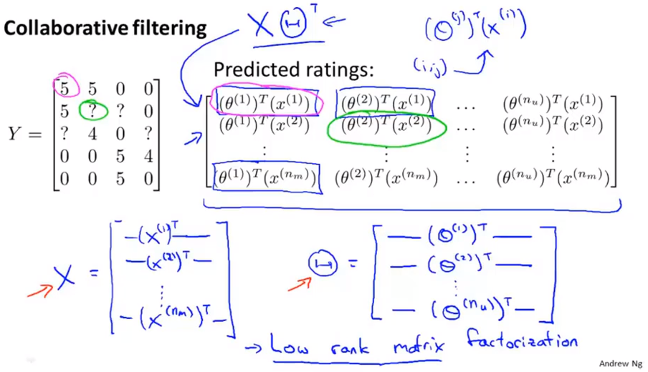
Chapter 17

Slide 21
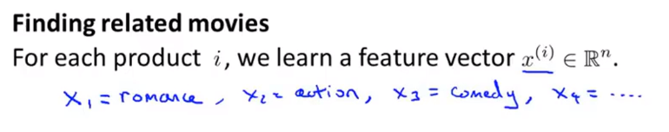
Chapter 17
Use the learned features to find related movies.
When you learned a set of features, you do not really know advance what the different features are going to be, But if you run the algorithm and perfectly the features will tend to capture what are the important aspects of different movies or different products or what have. What the important aspects that cause some users to like certain movies and cause some users to like different set of movie.
It’s actually often pretty difficult to go in to the learned features and come up with a human understandable interpretation of what these features really are. But in practice, the features, even though these features can be hard to visualize. It can be hard to figure out just what these features are. Usually, it will learn features that are very meaningful for capturing whatever are the most important or the most salient properties of a movie that causes you to like or dislike it.
Salient 显著的 突出的

Slide 22
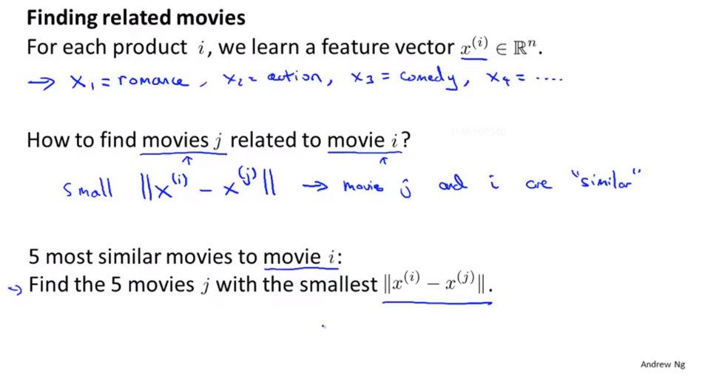
Chapter 17

Slide 23
Chapter 17
Recommender Systems
Implementational detail Mean normalization

Slide 24
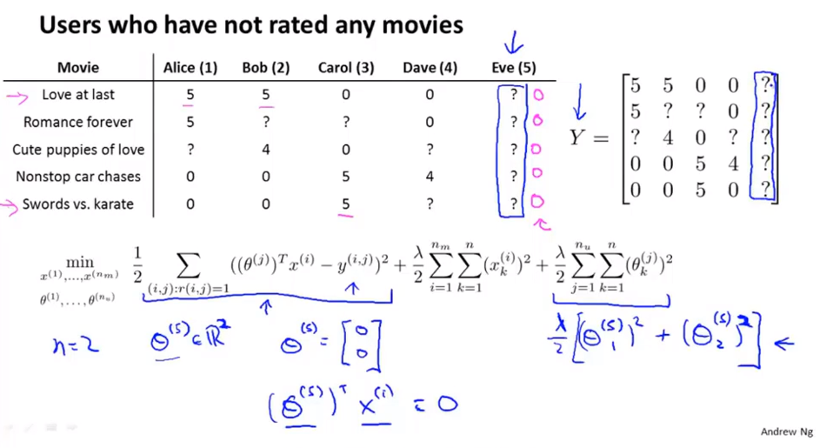
Chapter 17

Slide 25
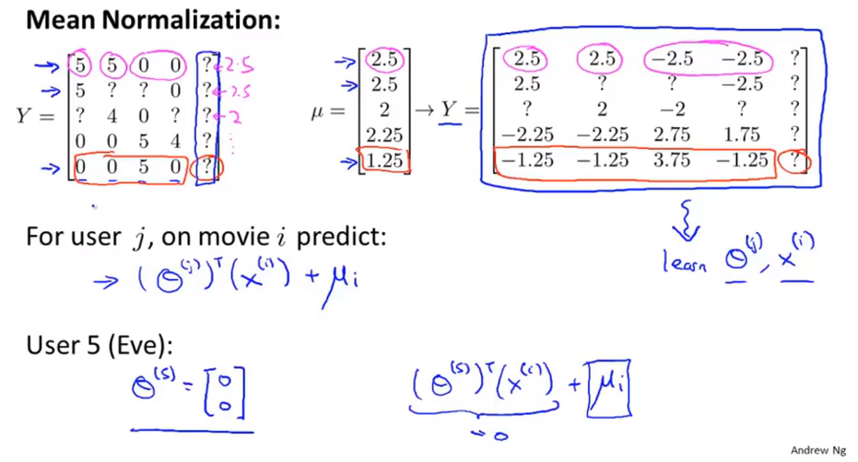
Chapter 17
This actually make sense, because it says that if Eve hasn’t rated any movies and we just don’t know anything about this new user Eve, what we’re going to do is just predict for each of the movies what are the average rating that those movies got.

Slide 26
Chapter 17
Finally, as an aside, mean normalization, where we normalized each row of the matrix y to have mean 0. In case you have some movies with no ratings. So it is analogous to a user who hasn’t rate anything, but in case you have some movies with no ratings, you can also play with versions of the algorithm where you normalize the different columns to have means zero, instead of normalizing the rows to have mean 0. although that’s maybe less important, because if you really have a movie with no ratings, maybe you just shouldn’t recommend that movie to anyone, anyway. And so, taking care of the case of a user who hasn’t rated anything might be more important than taking care of case of a movie that hasn’t gotten a single rating.
So to summarize, that’s how you can do mean normalization as a sort of pre-processing step for collaborative filtering. Depend on your dataset, this might sometime make your implementation work just a little bit better.

